Slide 1
Lab 05

Slide 2
ECB
Classes can be stereotyped (categorized) as
Control
Boundary
Entity.
These stereotypes are used to increase the semantic meaning of the classes and their usage in modeling situations.
These stereotypes are not found in the core of the UML specification. Rather, they are common stereotypes implemented in many UML tools and used during the design and analysis phase. They are based on the model-view-controller concept, where the entity is the model, the control is the controller, and the boundary is the view.

Slide 3
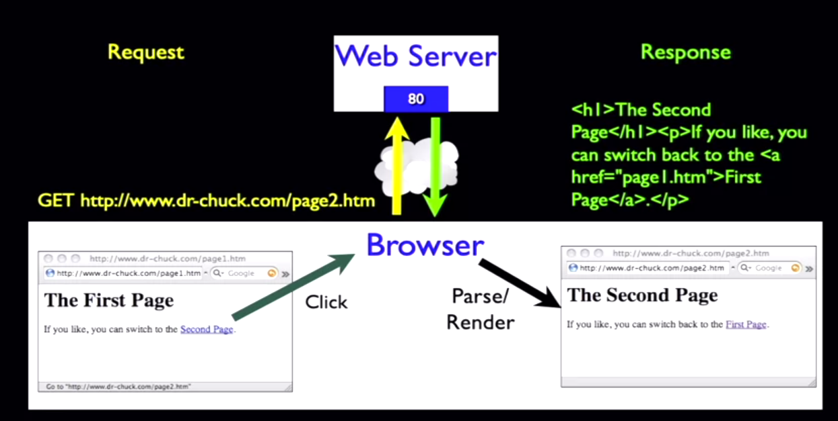
Model View Controller
Notes:
Request response
Web Server is controller
Pages are boundaries/Interfaces/Views
That cloud storing data is model/Entity

Slide 4
Entity, Boundary, Controller (ECB)
Controller- The code that does the thinking and decision making
Boundary- The HTML, CSS, etc. which makes up the look and feel of the application
Entity- The persistent data that we keep in the data store

Slide 5
The model-view-controller (MVC) concept is a well-used solution (pattern) for building systems with an entity model, which is presented and manipulated via a graphical user interface (GUI). Because these stereotypes are based on the MVC concept, they are very useful when dealing with GUI-based systems and also Web application
These stereotypes are used to analyze and to realize use cases in more detail. The analysis classes are an entity class (something to be stored in the system and implemented in many use cases), a boundary class (used to communicate with the external actors), or a control class (used to handle a specific use case or scenario, typically specialized to only one or a few use cases).

Slide 6
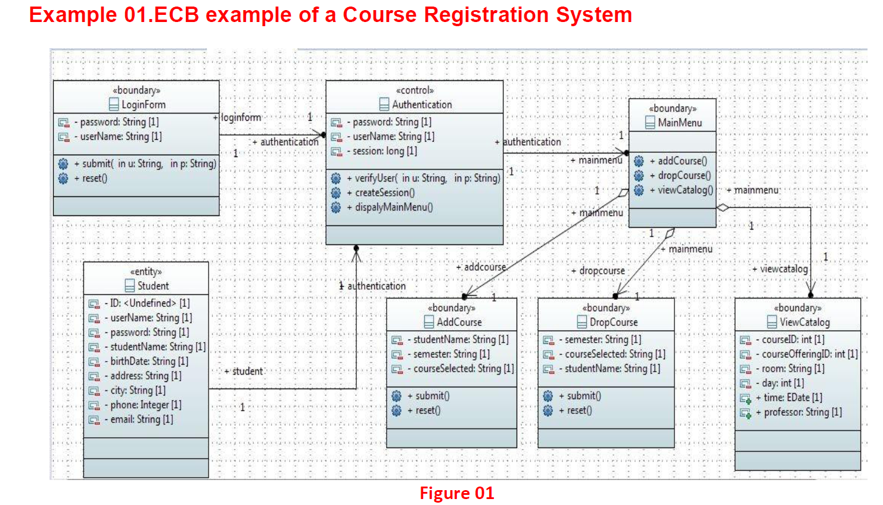

Slide 7
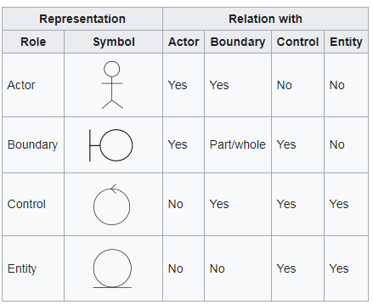
Robustness Diagram
Robustness diagrams allow to visually represent the relation between entities, controls, boundaries and actors.

Slide 8
Use case ID | UC103
Use case Name | Search Products
Actors | Customer
Description | Search for products based on some criteria
 | The customer wants to browse among products or the customer would like to search for certain products
Precondition | Customer starts web browser
Postcondition | Search results meeting the criteria are displayed
Normal Flow | Customer visits the application home page Customer clicks the search button Search page is displayed by the system Customer enters search criteria The system validates the criteria provided The system looks up the catalog to find the products that meet the criteria Search results page is displayed with the product fulfilling the criteria
Alternative flows | Refine Search Results The following steps are added: Customer refines search results by providing additional criteria Step 5-7 are re-executed
Exceptions | In step 5, if search criteria is invalid or even missing then Step 3 (display search page) will be executed along with some hints on valid criteria Step 6, if no products found meet the criteria then Step 3 (display search page) will be executed along with the error message “Product not found”
Included | None
Notes and issues | None

Slide 9
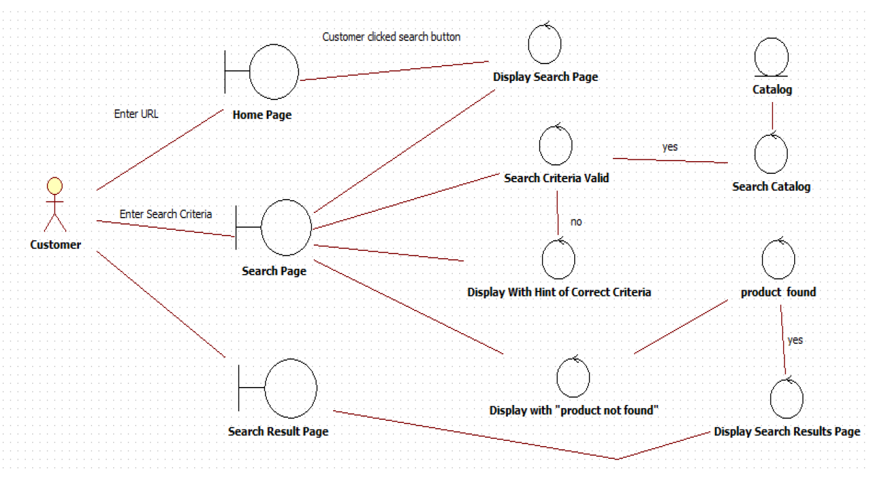
Robustness Diagram

